Slide 1
CREDIT EDA CASE STUDY
Junaita Davakumar B & Abhishek Awari

Slide 2
Problem Statement: To use EDA techniques to analyze loan applications and infer from them to make it more profitable for the loan lender

Slide 3
Null value correction
Columns with above 50% null values have been dropped

Slide 4
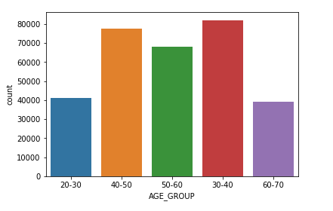
Most of the people applying for loan are in the age group 30-40, followed by people in the age group 40-50

Slide 5
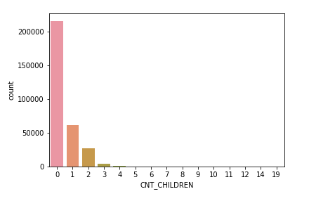
Most of the people applying for loan had no children
A person having 19 children can be an error as the age of the person was in the age group 20 – 30.

Slide 6
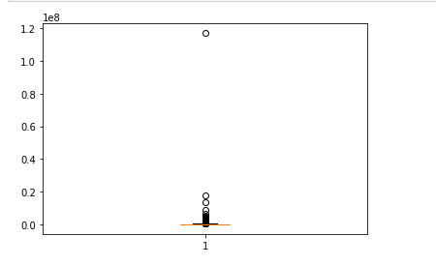
There are a lot of outliers in the total income of the people applying for loan
This shows that there is a vast crowd with completely different economic status applying for loan

Slide 7
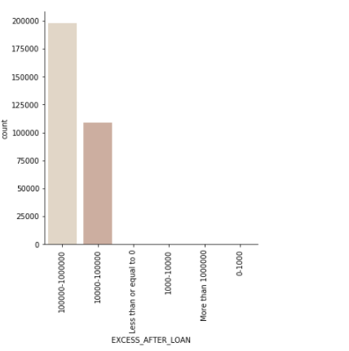
Excess after loan is the difference between the annuity and the income, that is the amount of money left with the person after paying the loan
It is observed that there are some where the excess after loan is less than zero

Slide 8
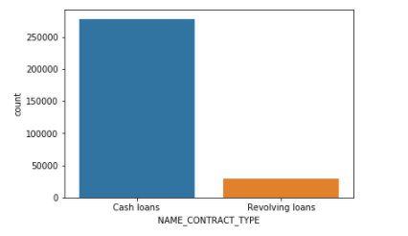
People applying for cash loans are more than people applying for revolving loans

Slide 9
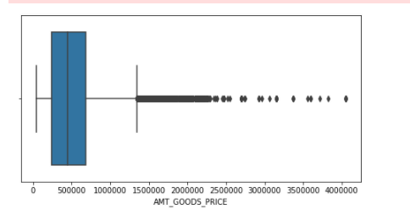
Outliers in the goods price for which loan is applied are shown here

Slide 10
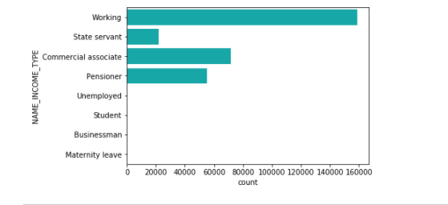
Most of the people applying for loans belong to the working class

Slide 11
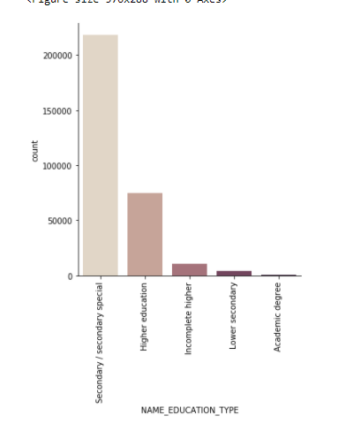
Most of the people applying for loan have undergone only secondary education
Very few people with academic degree apply for loan

Slide 12
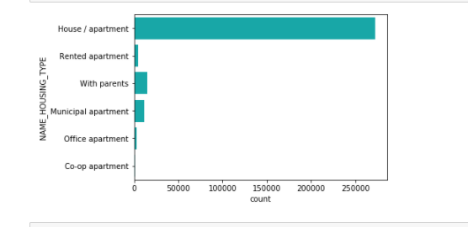
Most of the applicants live in a house/apartment

Slide 13
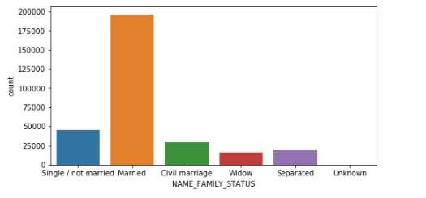
Most of the applicants are married people

Slide 14
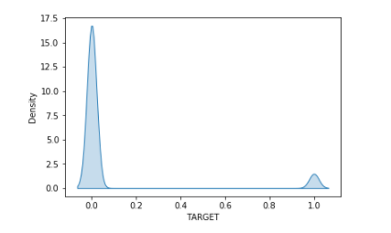
It is observed that there is imbalance in the data. The number of non-defaulters (0) is higher than the number of defaulters (1)

Slide 15
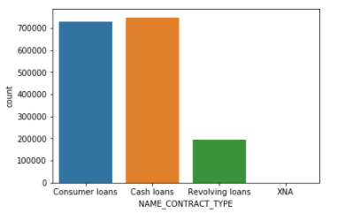
In the previous applications, the number of cash loans was slightly higher than the number of consumer loans and much higher than the number of revolving loans

Slide 16
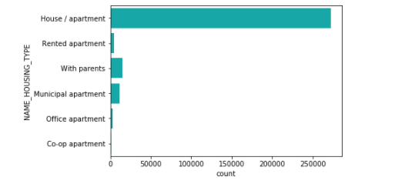
In the previous applications, most of the applicants owned a house/apartment

Slide 17
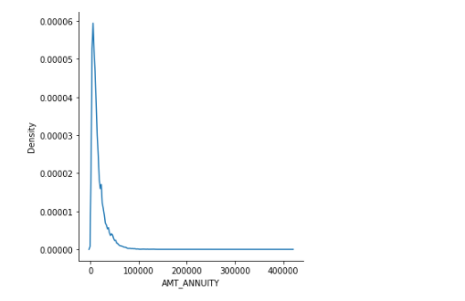
In the previous applications, the density of people with very low annuity was high

Slide 18
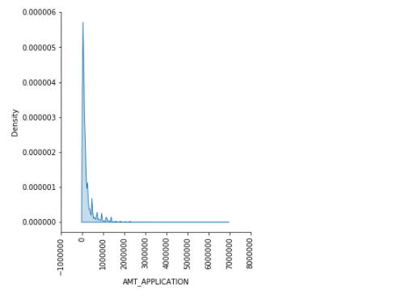
As the loan amount increased, the number of loans sanctioned decreased, in the previous applications

Slide 19
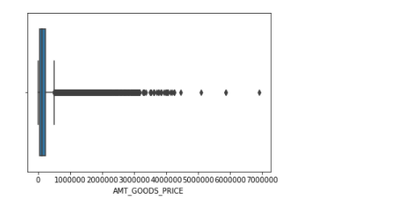
There are a lot of outliers in the goods price amount, in the previous applications

Slide 20
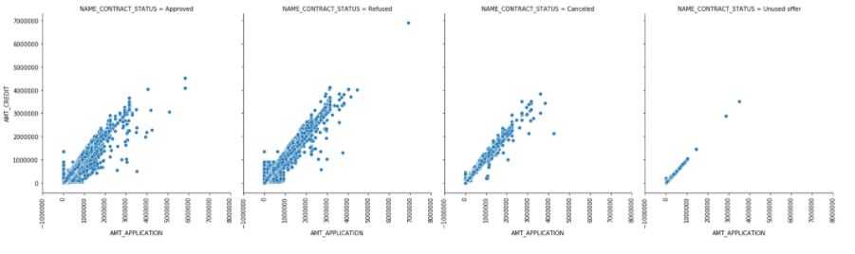
There is positive correlation between the amount applied and the amount credited in previous applications

Slide 21
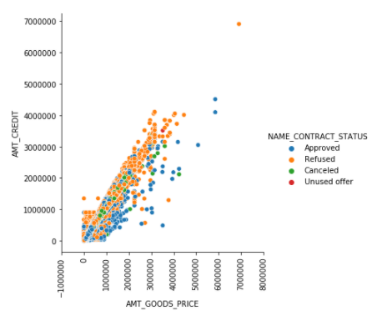
There is positive correlation between the price of the goods and the amount that has been credited, in the previous applications

Slide 22
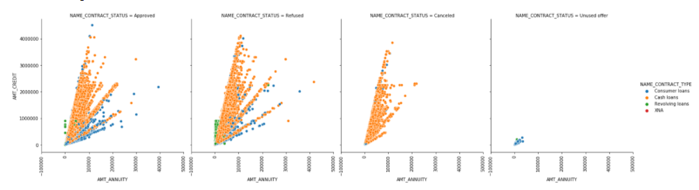
There is positive correlation between the annuity and the amount credited, in the previous applications

Slide 23
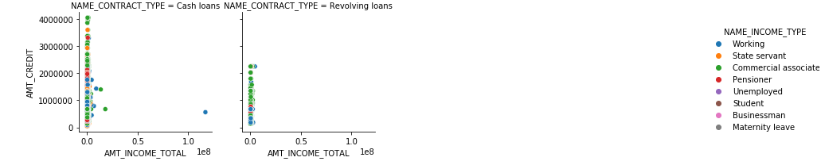
There is no correlation between the amount credited and the total income of the applicants, in the previous applications

Slide 24
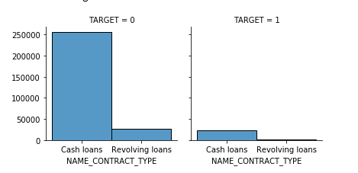
There are more non-defaulters in cash loans compared to revolving loans

Slide 25
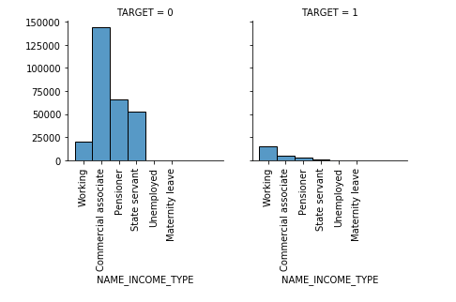
The maximum number of non-defaulters was in the commercial associate category
The maximum number of defaulters was in the working category

Slide 26
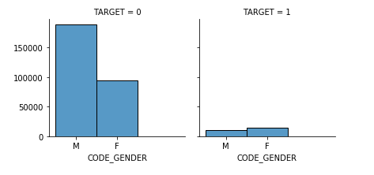
There are more female defaulters compared to male defaulters

Slide 27
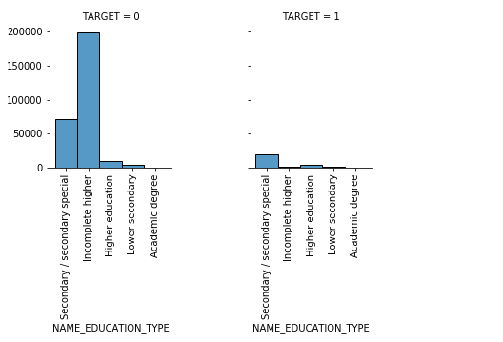
Mostly, people with incomplete higher education were non- defaulters

Slide 28
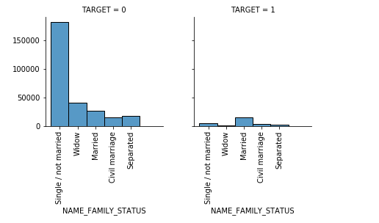
Widows and separated people are non-defaulters compared to married people
The probability of single/not married people to be defaulters is less

Slide 29
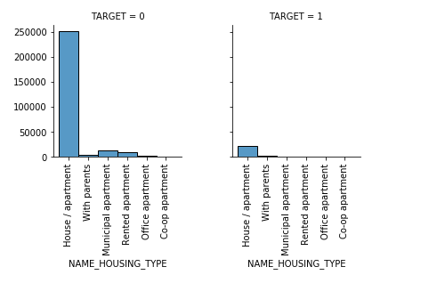
The probability of people living in a rented apartment to be defaulters is less

Slide 30
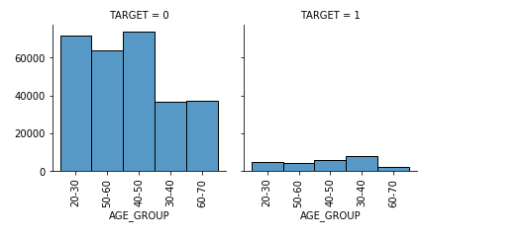
People in the 40-50 age group and 20-30 age group default less
People in the 30-40 age group default more

Slide 31
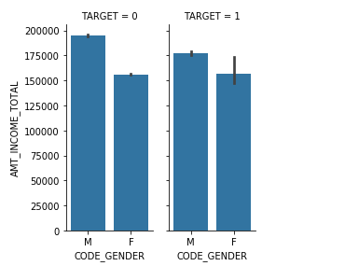
Among the males, higher income males defaulted less
Total income does not have a say in female defaulters

Slide 32
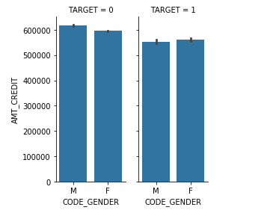
For both males and females, the non-defaulters had higher amount credited

Slide 33
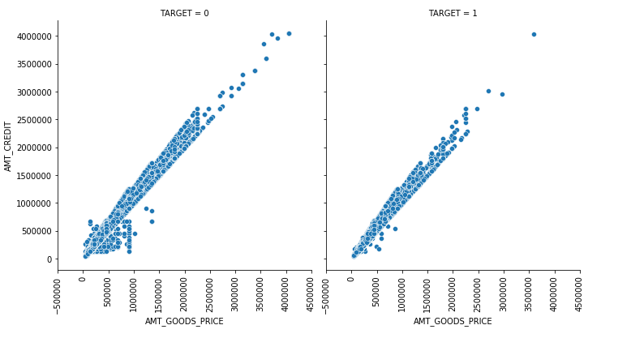
There is positive correlation between the amount credited and the price of goods in both default and non-default cases

Slide 34
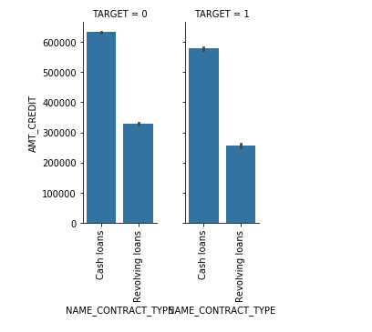
For both cash loans and revolving loans, non-defaulters are credited more amount compared to defaulters

Slide 35
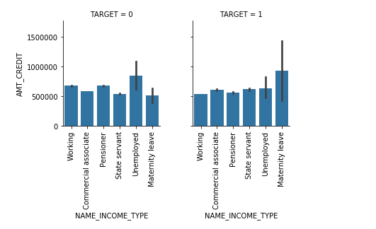
Defaulters in maternity leave are credited more amount compared to non-defaulters in maternity leave
Unemployed defaulters are credited less amount compared to unemployed non-defaulters

Slide 36
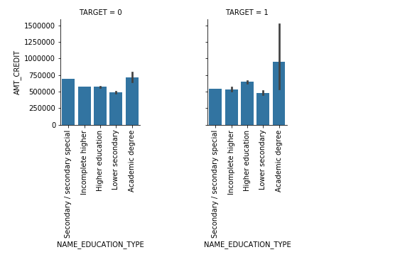
Defaulters with academic degree are credited more amount

Slide 37
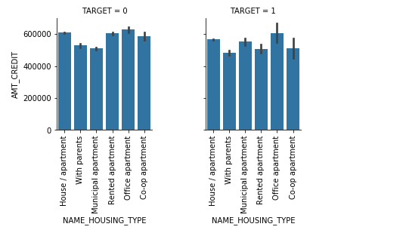
Defaulters living in municipal apartments were credited more amount
Defaulters living in rented apartment were credited less amount

Slide 38
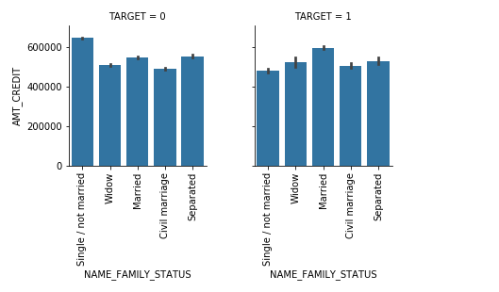
Single/not married people who were non-defaulters got a higher credit
Married defaulters got a higher credit amount compared to married non-defaulters

Slide 39
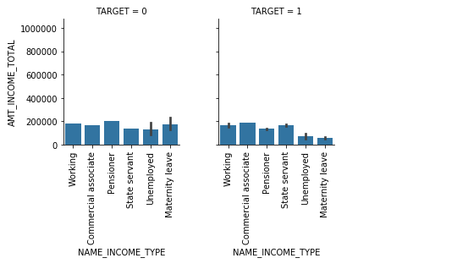
Among the pensioners, people with higher total income were non-defaulters compared to people with less total income

Slide 40
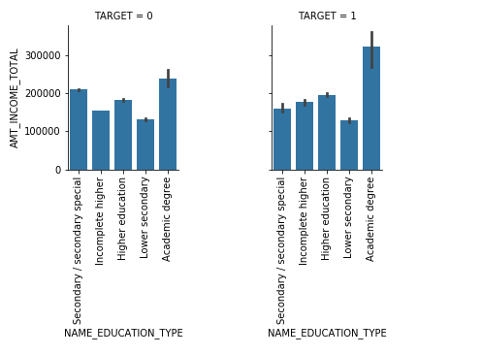
Among people having an academic degree, people with higher total income were defaulters compared to people with less total income

Slide 41
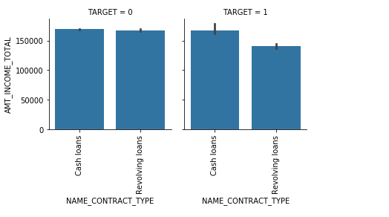
Single/not married people who were non-defaulters got a higher credit
Married defaulters got a higher credit amount compared to married non-defaulters

Slide 42
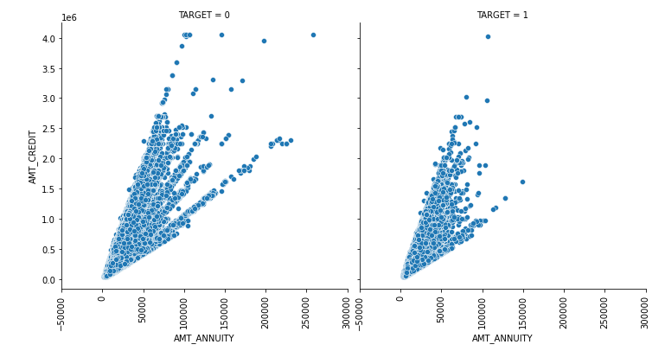
There is positive correlation between amount credited and annuity

Slide 43
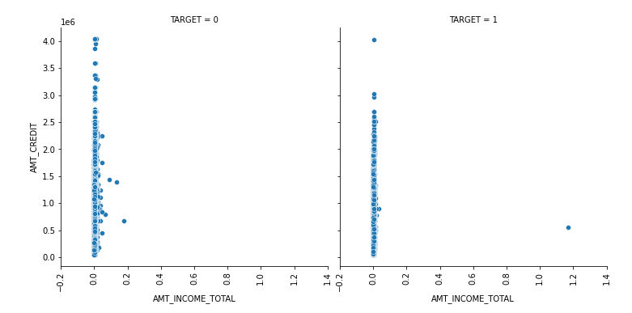
There is no correlation between amount credited and the total income

Slide 44
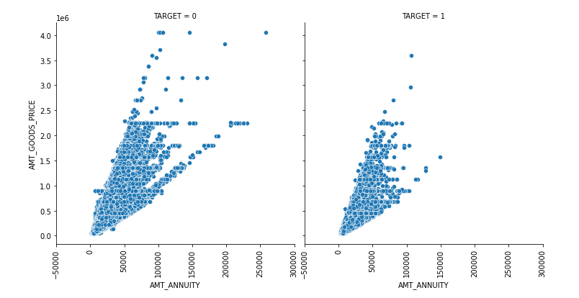
There is positive correlation between the price of goods and the annuity amount

Slide 45
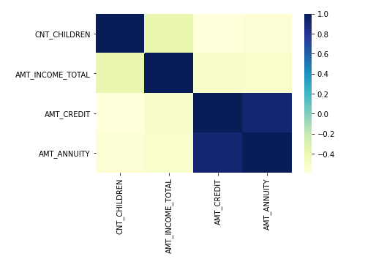
For the defaulters, there is not much correlation between amount credited and the total income
There is high correlation between amount credited and annuity amount

Slide 46
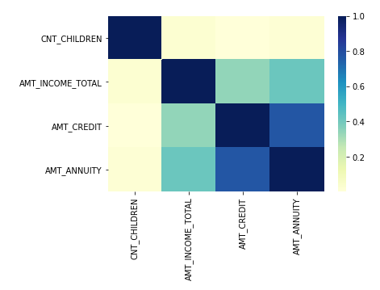
For the non-defaulters, there is correlation between the total income and the amount credited

Slide 47
CONCLUSIONS
There are more female defaulters compared to male defaulters
Widows and separated people are non-defaulters compared to married people
The probability of single/not married people to be defaulters is less
The probability of people living in a rented apartment to be defaulters is less
People in the 40-50 age group and 20-30 age group default less compared to people in the 30-40 age group
Males higher income males defaulted less, while total income does not influence female defaulters
For the non-defaulters, there is correlation between the total income and the amount credited. People with a higher total income can be given loans.
Age, gender, marital status and total income should be considered while giving loans

Slide 48
Thank you !!!

